Slide 1
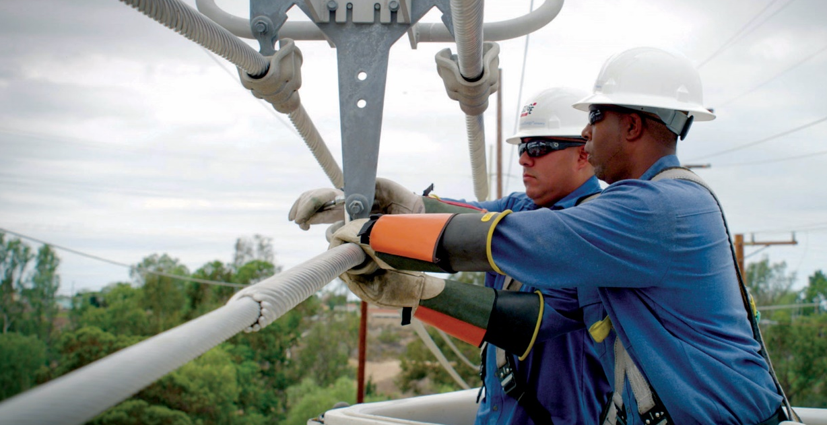
City of San Diego and SDG&E Franchise
A Partnership for the Benefit of San Diegans

Slide 2
What is the SDG&E Franchise Agreement?
The City of San Diego and SDG&E franchise agreement creates a partnership that grants SDG&E the right to use the public right-of-way to deliver power to the City of San Diego in exchange for a fee.
1971
1972
2002
The City of San Diego and SDG&E enter into a 50-year gas and electric franchise agreement.
California Public Utilities Commission approves franchise agreement.
SDG&E collects 3% franchise fees, significantly higher than average franchise fees across the state and nation.
The City of San Diego and SDG&E renegotiated fees to include an additional 3.53% undergrounding surcharge collected from City residents.
Average electric bill impact for San Diego residents is
$11/month for franchise fee and undergrounding surcharge.
SDG&E pays the City of San Diego approximately $130 million annually in franchise fees and undergrounding surcharges.
$11
$130
million

Slide 3
Projected Timeline
February
MARCH
April
May/june
Collect feedback from RFEI & Community Outreach
Draft agreement presented for public review and input at City Council/Committee
Franchise agreement released as Invitation to Bid (ITB)
Draft Franchise Fee Agreement
July/august
September
October - january
Evaluate responses to (ITB) and form recommendation for City Council
Present recommendation of proposed franchise agreement to City Council/Committee
Receive CPUC approval (if necessary)
3

Slide 4
Modernizing the Franchise Agreement to a term that aligns with local and statewide climate goals
Rather than the current 50-year franchise agreement, a minimum 25 or 30-year term with performance metrics is needed to allow enough time for the long-term investments necessary to achieve City and state goals.
SB100 60% Renewables
SB100 100% Zero-Carbon
SDG&E 45% Renewables
CAP 100% Renewables
2020
2030
2035
2045
25 years
4

Slide 5
Prioritizing Safety and Reliability
SDG&E has pioneered many wildfire safety innovations and is recognized as a role model in wildfire prevention and wildfire risk mitigation.
To address wildfire risk, SDG&E has:
Replaced 22,000 wood poles with steel poles,
Installed 191 weather stations and 100 cameras to monitor real-time conditions, and
Pursued numerous other innovations to make the power grid safer and stronger.
SDG&E provides 24/7 gas and electric service response teams to keep power and gas flowing to homes and businesses.

Slide 6
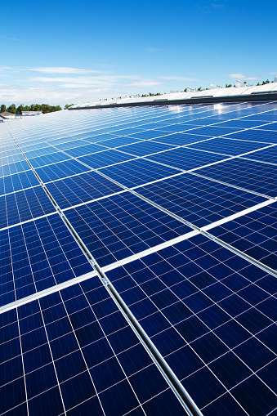
SDG&E’s Modern Electric Grid will Enable New Clean Technologies to be Built
SDG&E has designed, planned and operated an advanced and innovative grid that has allowed the City of San Diego to lead the nation in solar energy.
SDG&E is a national leader in energy storage – the key to a 100% carbon free future – and unveiled what was then the world’s largest energy storage facility in 2017.
In 2017, SDG&E developed and unveiled a Renewable Meter Adapter to accelerate adoption of rooftop solar.
Collectively, this has saved customers more than $11M
SDG&E’s track record of renewable integration, storage investments and reliability are critical to achieving shared goals outlined in the City’s Climate Action Plan.

Slide 7
SDG&E Leads the State in Renewable Energy Procurement
Utility (Power Mix) | Eligible Renewable Percentage | Geothermal | Total Natural Gas | Total Coal Percentage | Total Hydro-electric | Unspecified Percentage
San Diego Gas & Electric | 44% | 0% | 39% | 0% | 0% | 17%
City of Roseville | 40% | 10% | 22% | 0% | 13% | 24%
City of Pasadena | 38% | 1% | 11% | 31% | 3% | 11%
City of Anaheim | 33% | 6% | 20% | 38% | 2% | 7%
Pacific Gas & Electric Company | 33% | 5% | 20% | 0% | 18% | 2%
Burbank Water & Power | 32% | 3% | 30% | 31% | 1% | 0%
Southern California Edison | 32% | 8% | 20% | 0% | 8% | 34%
Los Angeles Department of Water & Water | 32% | 7% | 30% | 18% | 3% | 6%
Sacramento Municipal Utility District | 20% | 2% | 54% | 0% | 26% | <1%
Pacificorp | 9% | 0% | 11% | 58% | 6% | 16%
13%
30%
33%
24%

Slide 8
SDG&E Will Help Support the City’s Clean Energy Vision
Renewable Portfolio Standard (RPS)
2017 total: 44%
Current estimated total:
45%
~60 contracts in CA
First utility to commit to 33% RPS and to reach 40%.
SDG&E AFV Fleet
600 employees operating
company Alternative-fuel Vehicles (AFVs)
287 workplace
charging stations
Fleet: 163 electrified;
81 natural gas
AFVs make up 15% of
SDG&E’s vehicles fleet
Energy Storage
Existing: 84 MW
(GRC 6 MW | Expedited 38 MW Lake Hodges 40 MW)
Customer owned: 54 MW
EcoChoice*
Total customers:
3,084 | 45 MW
Residential:
2,257 | 3 MW
Employees: 58
Commercial/Industrial: 828/42 MW
* EcoChoice: SDG&E buys renewable energy on the customer’s behalf from generating facilities designated for EcoChoice facilities.

Slide 9
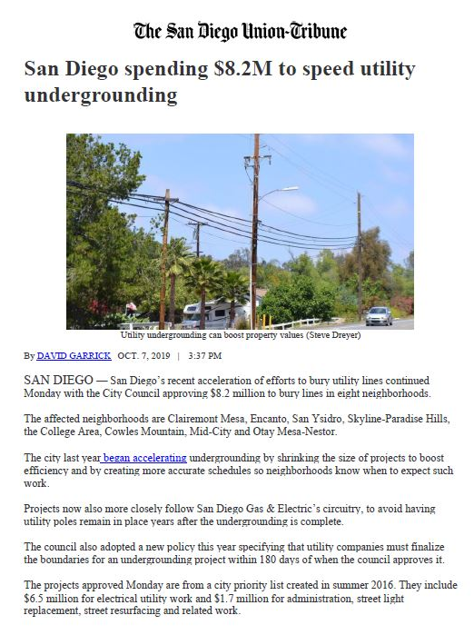
SDG&E Has Partnered with the City of San Diego To Expedite Undergrounding
The City of San Diego's system is 74% underground and 26% overhead.
SDG&E constructs undergrounding projects per the Franchise Agreement terms and CPUC Rule 20.
As of December 2018, SDG&E and the City have committed to complete approximately 97 miles of undergrounding by June 2022.
Date of original undergrounding agreement: 2004
In fiscal year 2019, SDG&E completed about 23 miles and currently has about 40 miles in construction and 90 miles in design.

Slide 10
Key Considerations
Rather than a 50-year franchise agreement, a minimum 25 or 30-year term with performance metrics is needed to align with City and statewide goals.
The City of San Diego deserves to be served by a utility that:
Prioritizes safety and reliability
Focuses on the welfare and job security of its dedicated workforce
Is a proven expert in the advanced grid architecture needed to support Community Choice Energy
Is committed to partnering with the City to help achieve its CAP goals
Accelerates undergrounding in San Diego neighborhoods

Slide 11
Appendix

Slide 12
A Significant Source of City Revenue
$65M
annually
$65M
annually
City of San Diego Fiscal Year 2020 Adopted Budget
Notes:
SDG&E’s franchise fees accounts for more than 80% of the City’s total franchise fee revenues.
The majority of SDG&E’s franchise fee revenue ($51.8M) goes directly into the City’s general fund, which supports City services like police and fire-rescue departments.
The remainder ($17M) is invested in our Environmental Growth Fund, which is used to help protect and maintain our parks, parkland and open space.
An additional $63.8 million is dedicated to undergrounding utility lines in the City of San Diego.

